Slide 1
Number of 4-contractible edges in 4 -connected graphs
Yoshimi Egawa
(Tokyo University of Science)

Slide 2
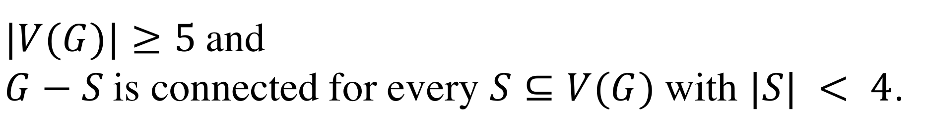
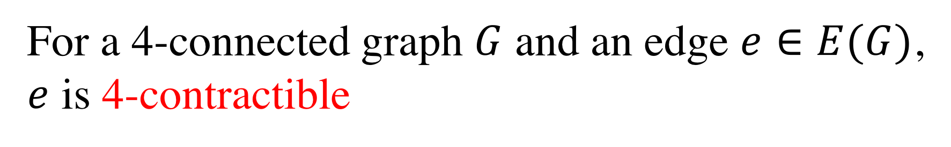
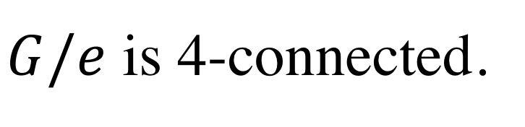
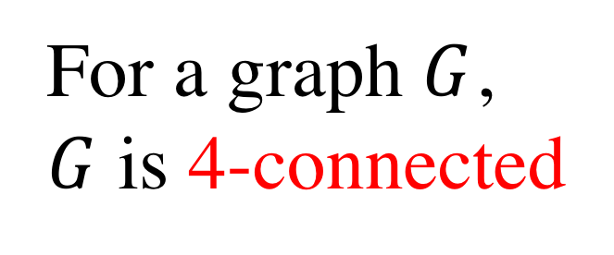
For a graph $G$,
$G$ is 4-connected
def
$|V(G)|≥5$and
$G−S$is connected for every $S⊆V(G)$with $|S| < 4$.
For a 4-connected graph $G$ and an edge $e∈E(G)$,
$e$ is 4-contractible
def
$G/e$ is 4-connected.
$$E_{c}\left(G\right)≔\left\{e∈E\left(G\right) | e is \text{4−}\text{contractible}\right\}$$

Slide 3
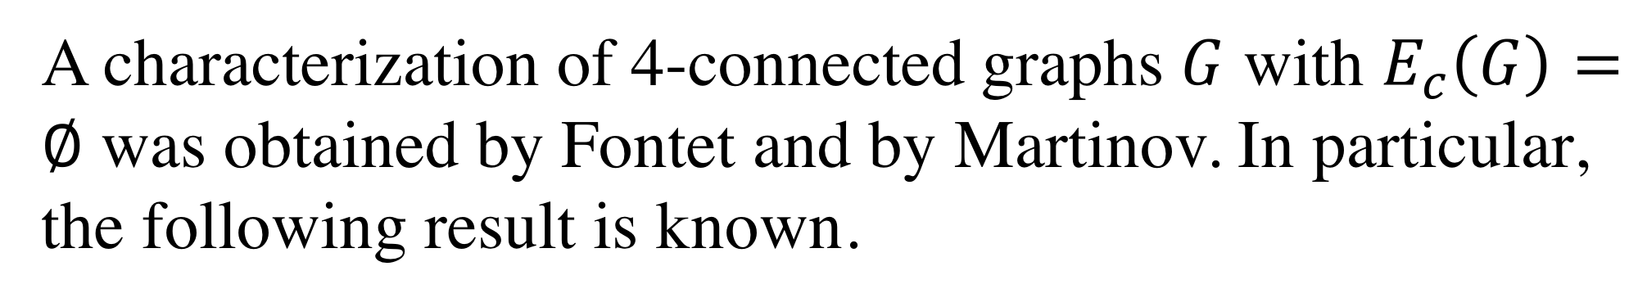
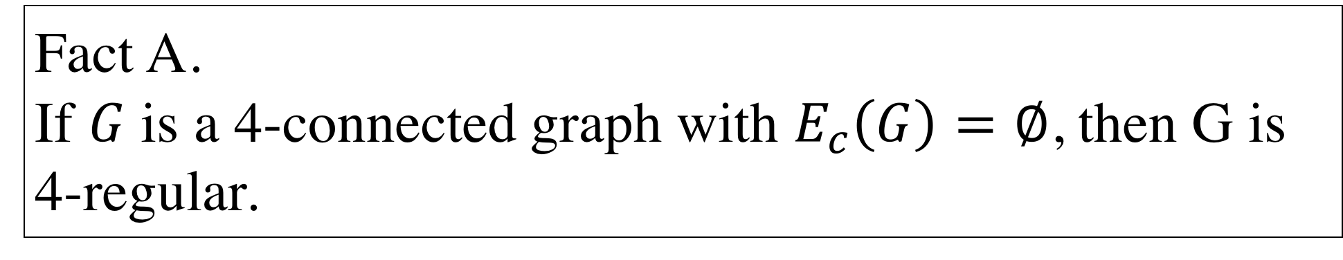
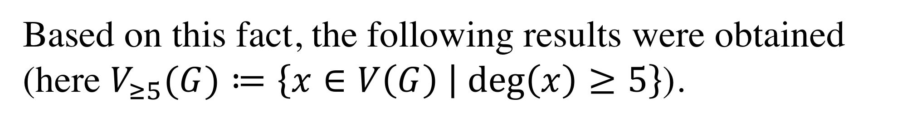
A characterization of 4-connected graphs $G$ with $E_{c}\left(G\right)=∅$ was obtained by Fontet and by Martinov. In particular, the following result is known.
Fact A.
If $G$ is a 4-connected graph with $E_{c}\left(G\right)=∅$, then G is 4-regular.
Based on this fact, the following results were obtained (here $V_{≥5}(G)≔\left\{x∈V\left(G\right) | deg\left(x\right)≥5\right\}$).

Slide 4
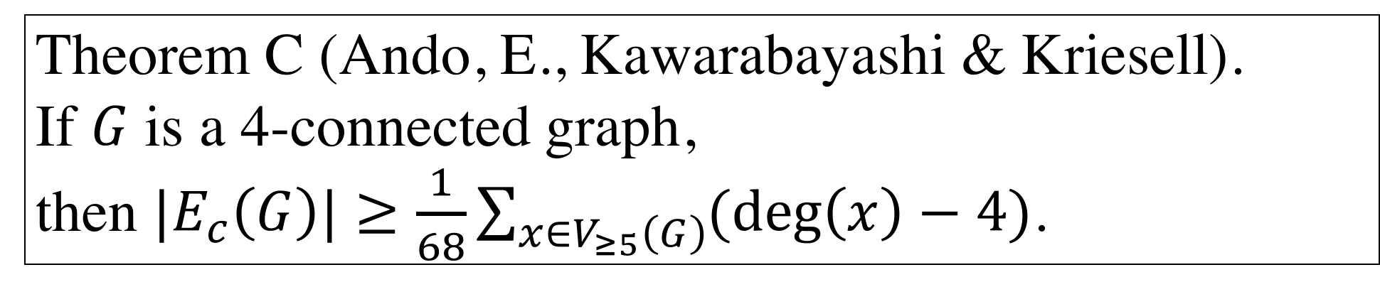
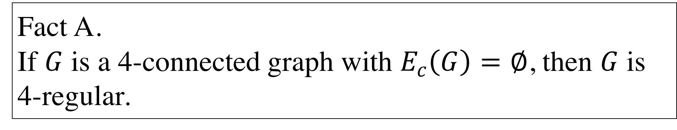
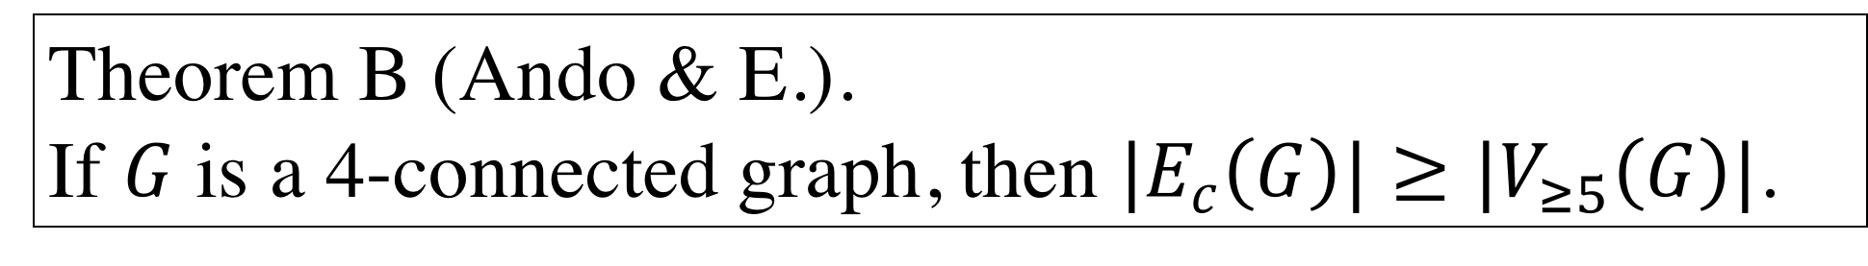
Fact A.
If $G$ is a 4-connected graph with $E_{c}\left(G\right)=∅$, then $G$ is 4-regular.
Theorem B (Ando & E.).
If $G$ is a 4-connected graph, then $|E_{c}\left(G\right)|≥|V_{≥5}\left(G\right)|$.
Theorem C (Ando, E., Kawarabayashi & Kriesell).
If $G$ is a 4-connected graph,
then $|E_{c}\left(G\right)|≥\frac{1}{68}\sum_{x∈V_{≥5}\left(G\right)}{(\deg\left(x\right)−4)}$.

Slide 5
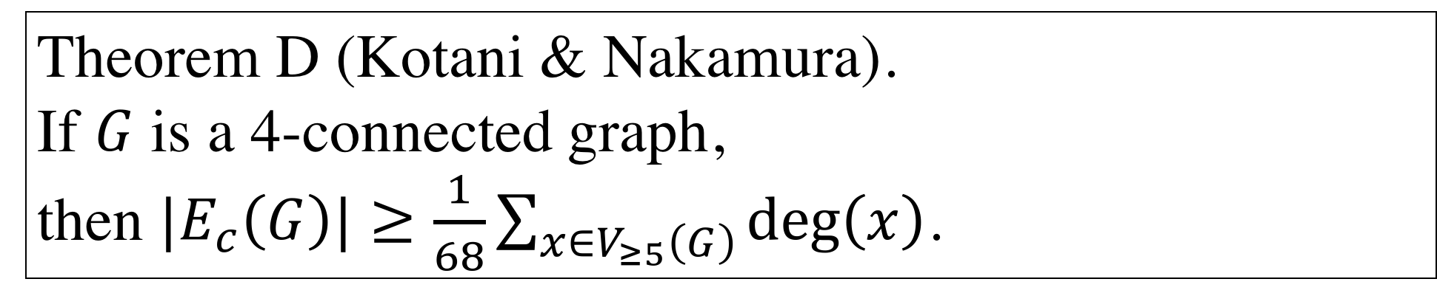
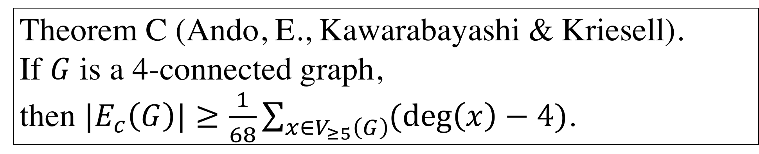
Theorem C (Ando, E., Kawarabayashi & Kriesell).
If $G$ is a 4-connected graph,
then $|E_{c}\left(G\right)|≥\frac{1}{68}\sum_{x∈V_{≥5}\left(G\right)}{(\deg\left(x\right)−4)}$.
The following result has recently been obtained.
Theorem D (Kotani & Nakamura).
If $G$ is a 4-connected graph,
then $|E_{c}\left(G\right)|≥\frac{1}{68}\sum_{x∈V_{≥5}\left(G\right)}{\deg\left(x\right)}$.

Slide 6

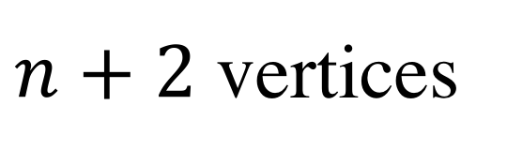
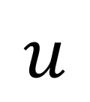
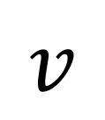
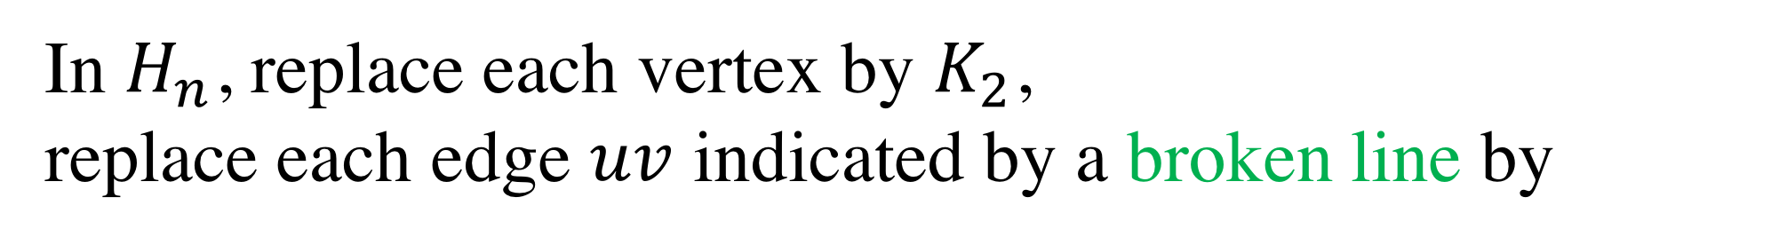
$n+2$ vertices
$$:H_{n}$$
In $H_{n}$, replace each vertex by $K_{2}$,
replace each edge $uv$ indicated by a broken line by
$$u$$
$$v$$

Slide 7
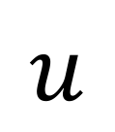
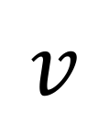
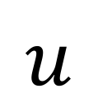
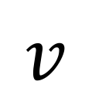
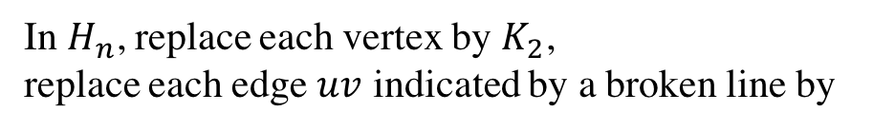
In $H_{n}$, replace each vertex by $K_{2}$,
replace each edge $uv$ indicated by a broken line by
$$u$$
$$v$$
$n+2$ vertices
$$:H_{n}$$
and replace each edge $uv$ indicated by a solid line by
$$u$$
$$v$$

Slide 8

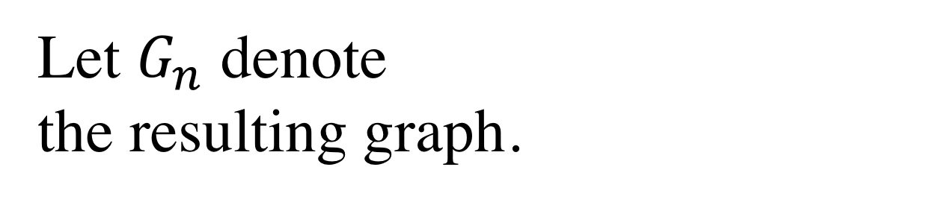
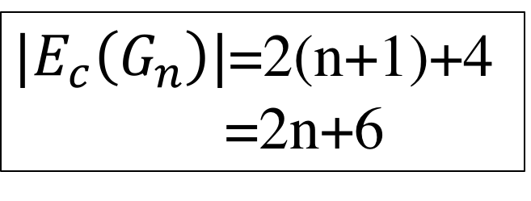

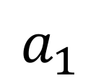
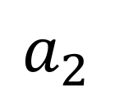






$$b_{11}$$
Let $G_{n}$ denote
the resulting graph.
$$b_{12}$$
$$a_{1}$$
$$b_{21}$$
$$b_{22}$$
$$a_{2}$$
$$:H_{1}$$
$$b_{31}$$
$$:G_{1}$$
$|E_{c}\left(G_{n}\right)|$=2(n+1)+4
=2n+6
$$b_{32}$$

Slide 9
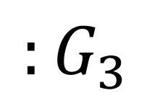
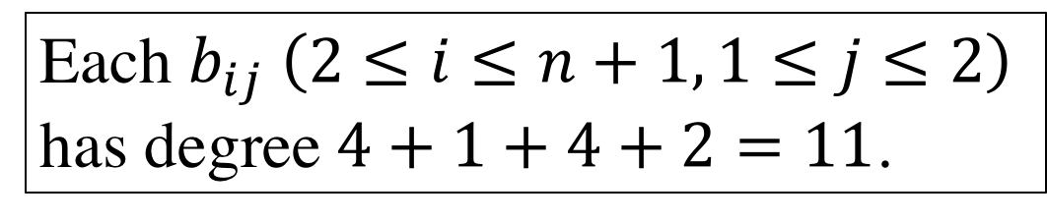
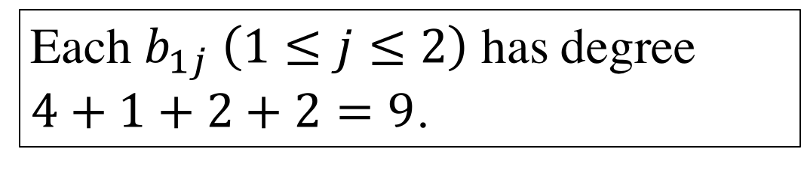
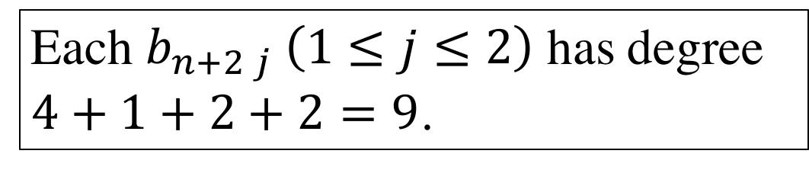

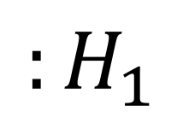
Each $b_{ij} \left(2≤i≤n+1, 1≤j≤2\right)$
has degree $4+1+4+2=11$.
Each $b_{1j} \left(1≤j≤2\right)$ has degree
$4+1+2+2=9$.
$$:G_{3}$$
$$:G_{1}$$
Each $b_{n+2 j} \left(1≤j≤2\right)$ has degree
$4+1+2+2=9$.
$$:H_{1}$$

Slide 10
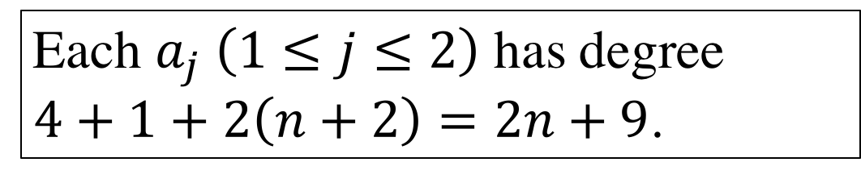
Each $a_{j} \left(1≤j≤2\right)$ has degree
$4+1+2\left(n+2\right)=2n+9$.
$$:G_{3}$$
$$:G_{1}$$
$$:H_{1}$$

Slide 11
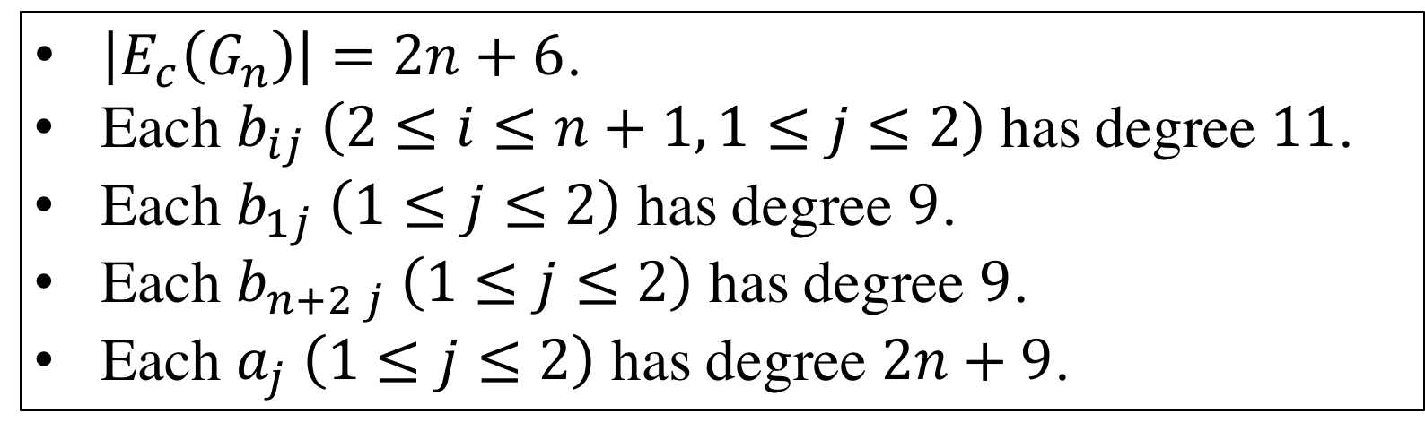
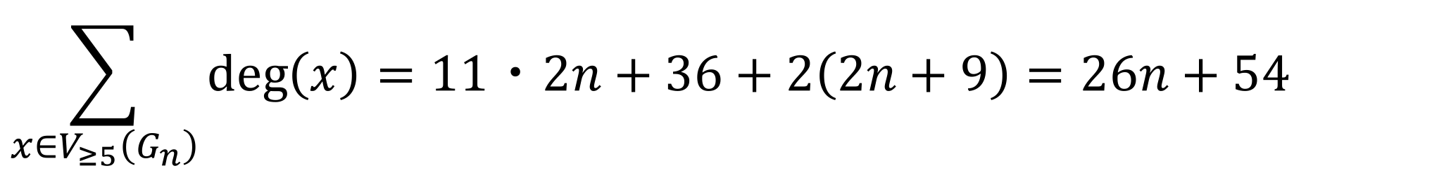
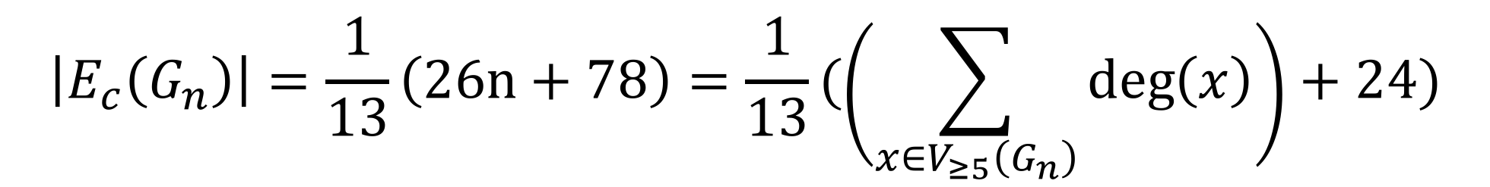
$\left|E_{c}\left(G_{n}\right)\right|=2n+6$.
Each $b_{ij} \left(2≤i≤n+1, 1≤j≤2\right)$ has degree $11$.
Each $b_{1j} \left(1≤j≤2\right)$ has degree $9$.
Each $b_{n+2 j} \left(1≤j≤2\right)$ has degree $9$.
Each $a_{j} \left(1≤j≤2\right)$ has degree$2n+9$.
$$\sum_{x∈V_{≥5}\left(G_{n}\right)}{\deg\left(x\right)}=11・2n+36+2\left(2n+9\right)=26n+54$$
$$\left|E_{c}\left(G_{n}\right)\right|=\frac{1}{13}\left(26n+78\right)=\frac{1}{13}(\left(\sum_{x∈V_{≥5}\left(G_{n}\right)}{\deg\left(x\right)}\right)+24)$$

Slide 12
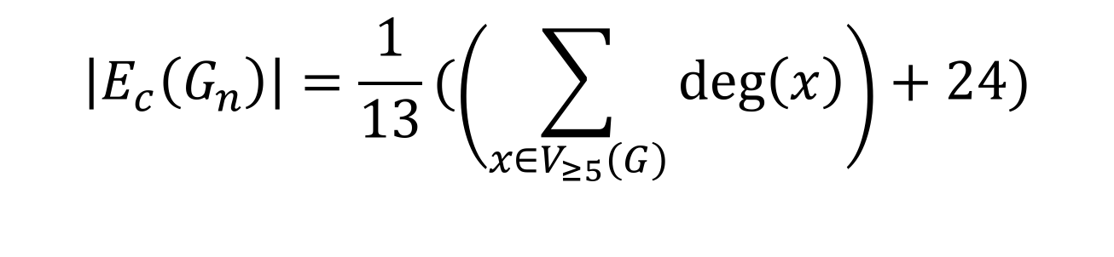
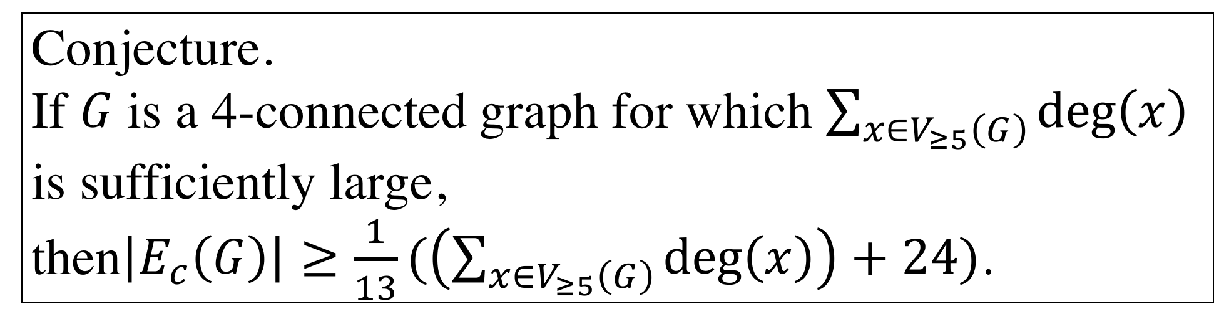
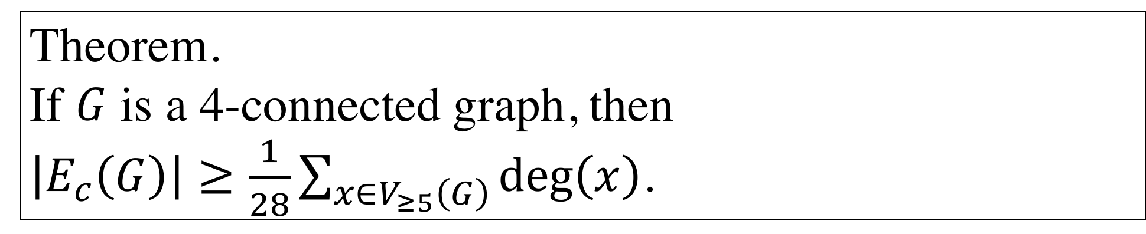
$$\left|E_{c}\left(G_{n}\right)\right|=\frac{1}{13}(\left(\sum_{x∈V_{≥5}\left(G\right)}{\deg\left(x\right)}\right)+24)$$
Conjecture.
If $G$ is a 4-connected graph for which $\sum_{x∈V_{≥5}\left(G\right)}{\deg\left(x\right)}$ is sufficiently large,
then$\left|E_{c}\left(G\right)\right|≥\frac{1}{13}(\left(\sum_{x∈V_{≥5}\left(G\right)}{\deg\left(x\right)}\right)+24)$.
Theorem.
If $G$ is a 4-connected graph, then
$\left|E_{c}\left(G\right)\right|≥\frac{1}{28}\sum_{x∈V_{≥5}\left(G\right)}{\deg\left(x\right)}$.

Slide 13
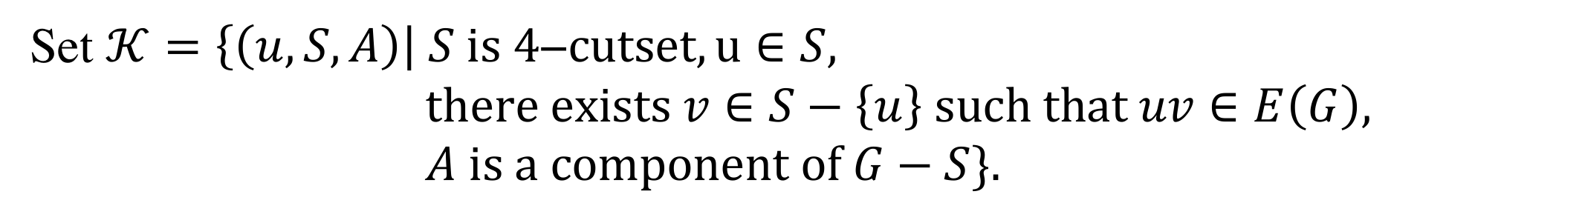
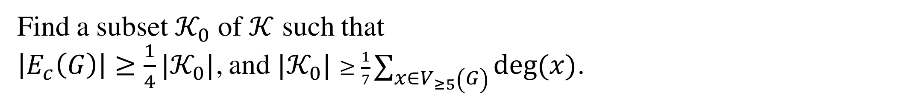
Outline of the proof.
Set $𝒦=\left\{\left(u,S,A\right)\right| S is 4\text{−}cutset, u∈S,$
$there exists v∈S−\left\{u\right\} such that uv∈E\left(G\right),$
$A is a component of G−S\}.$
Find a subset $𝒦_{0}$ of $𝒦$ such that
$\left|E_{c}\left(G\right)\right|≥\frac{1}{4}|𝒦_{0}|$, and $|𝒦_{0}|$ $≥\frac{1}{7}\sum_{x∈V_{≥5}\left(G\right)}{\deg\left(x\right)}$.

